Slide 1
Unsupervised Learning
Brandon Ooi

Slide 2
Outline
Unsupervised Learning
Proximity Measure
K-means Clustering
Hierarchical Clustering
Dimensionality Reduction

Slide 3
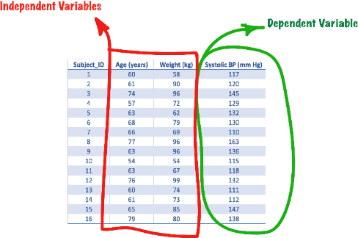
Supervised vs Unsupervised Learning
Supervised learning
Outcome/target variable (Dependent variable)
Input variables (Independent variable)
Unsupervised learning
No outcome/target variable (Dependent variable)
Only input variables (Independent variable)

Slide 4
Unsupervised Learning
Unlabelled data, structure of data not known beforehand
Deduce categories by itself by attempting to find a structure or pattern
Usually involves some form of clustering, such as hierarchical clustering, k-means clustering, etc
E.g. user behaviour analysis, network anomaly detection

Slide 5
Clustering
Cluster
A group of data objects among which there exists some degree of similarity.
Clustering (or cluster detection/analysis)
A process that divides a given data population into an appropriate number of clusters.
Usually exploratory and done before supervised learning to gain better understanding and insights of the data.
A form of unsupervised learning, works with data that is not labelled.
Outcome from clustering can be used as a feature for subsequent supervised learning stages.

Slide 6
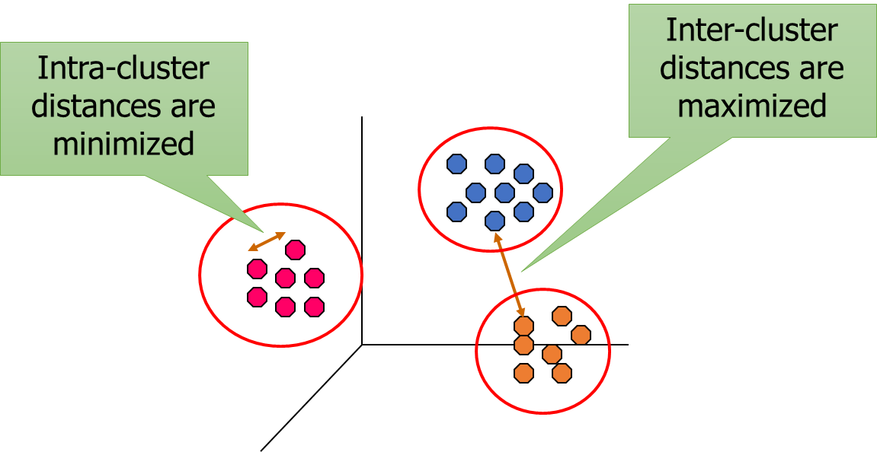
Cluster Analysis
Finding groups of objects such that the objects in a group will be similar (or related) to one another and dissimilar to (or unrelated to) the objects in other groups

Slide 7
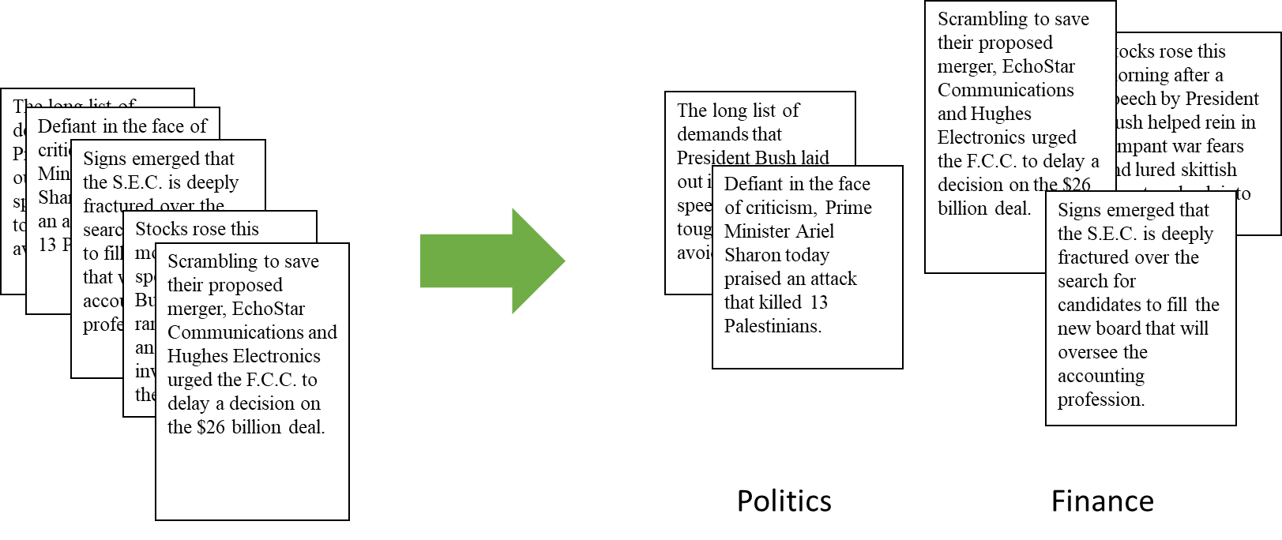
Clustering Example
Given some documents, how do we separate (or cluster) them?

Slide 8
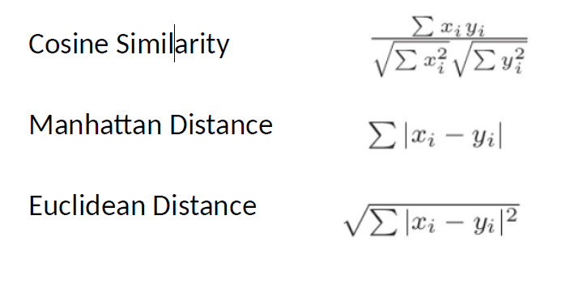
Proximity Measure
Here, we assume two points
x and y, with the subscript i
representing the dimension. If it is in two dimensions, x₁ and y₁ refer to the x coordinates of point
x and point y
For heterogenous features, need to scale the values between 0 and 1

Slide 9
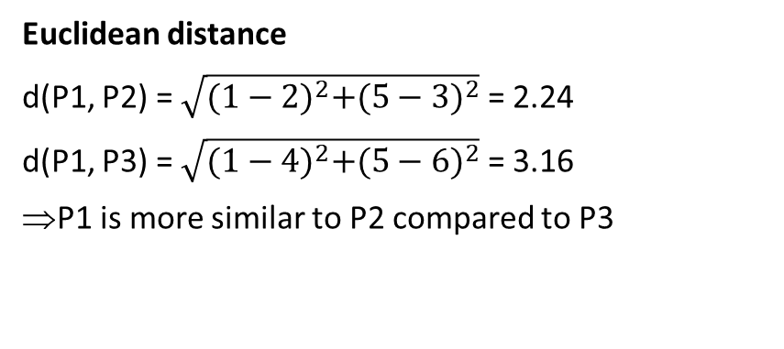
Distance Function - Example
P1 = (1, 5), P2=(2, 3), P3=(4, 6)
Euclidean distance
d(P1, P2) = $\sqrt{{(1−2)}^{2}+{(5−3)}^{2}}$ = 2.24
d(P1, P3) = $\sqrt{{(1−4)}^{2}+{(5−6)}^{2}}$ = 3.16
P1 is more similar to P2 compared to P3
Manhattan distance
d(P1, P2) = |1-2| + |5-3| = 1 + 2 = 3
d(P1, P3) = |1-4| + |5-6| = 3 + 1 = 4
=> P1 is more similar to P2 compared to P3

Slide 10
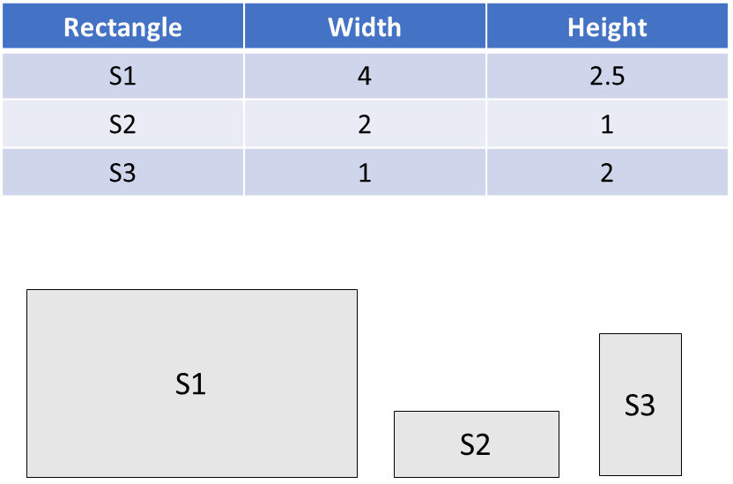
Cosine Similarity - Example
Consider the figures S1, S2 and S3 on the right
If we are interested in the relative features instead of size, S1 and S2 should be more similar to each other than S3.

Slide 11
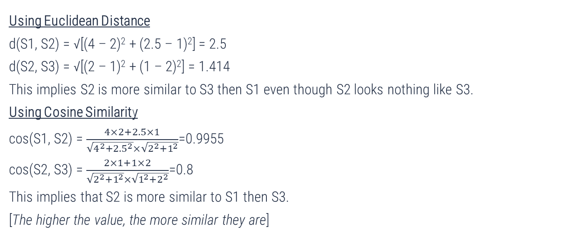
Cosine Similarity - Example
Using Euclidean Distance
d(S1, S2) = √[(4 – 2)² + (2.5 – 1)²] = 2.5
d(S2, S3) = √[(2 – 1)² + (1 – 2)²] = 1.414
This implies S2 is more similar to S3 then S1 even though S2 looks nothing like S3.
Using Cosine Similarity
cos(S1, S2) = $\frac{4×2+2.5×1}{\sqrt{4^{2}+{2.5}^{2}}×\sqrt{2^{2}+1^{2}}}$=0.9955
cos(S2, S3) = $\frac{2×1+1×2}{\sqrt{2^{2}+1^{2}}×\sqrt{1^{2}+2^{2}}}$=0.8
This implies that S2 is more similar to S1 then S3.
[The higher the value, the more similar they are]

Slide 12
Clustering Algorithms
Partitioning-based clustering
K-means clustering: Each cluster is represented by the center of the cluster
K-medoids clustering: Each cluster is represented by one of the objects in the cluster
K = number of clusters to be formed during the clustering process.
Hierarchical clustering
Agglomerative clustering (bottom up)
Divisive clustering (top down)

Slide 13
Steps for K-Means Clustering
Step 1: Decide the Number of Clusters.
There is no magic formula to calculate this before hand and it has to be an iterative process
Step 2: Assign Centroids.
Randomly select the number of observations or points. The number of centroid should be equal to the number of clusters
Step 3: Distance from Centroids.
Calculate the distance of each of the observations from the centroids and assign the points to the closest centroid.
Step 4: Recalculate Centroids.
The centroids of the clusters are recalculated. If the points in the cluster change due to assignment of the observations to different clusters in Step 3, the mean or the centroid of that cluster could change
Step 5: Repeat Step 3 & Step 4 until the Centroids do not move.
Sometimes, the centroid may take a long time to stabilize or might never stabilize. In such cases, we can stop after a certain number of iterations or if the centroid move less a certain threshold.

Slide 14
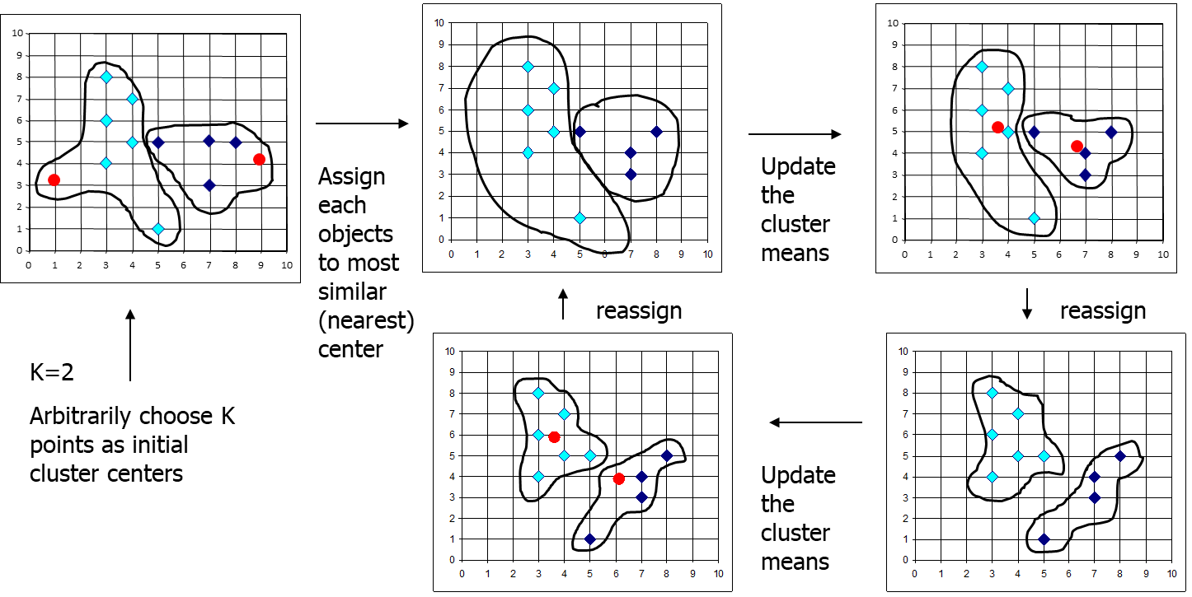
K-Means Clustering Algorithm

Slide 15
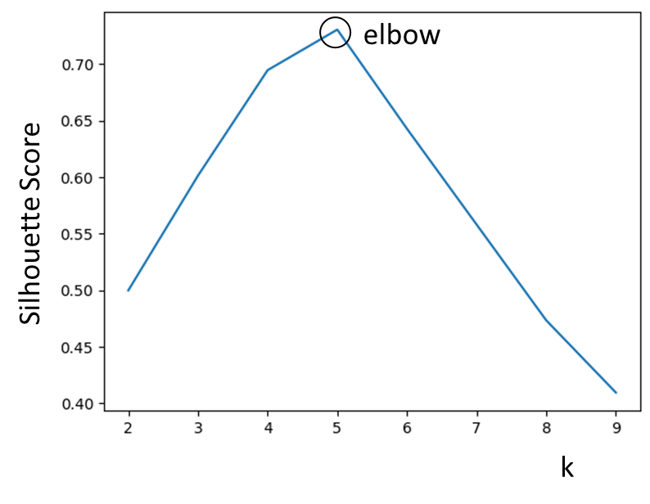
How To Choose k?
Usually, the business problem or practical constraints will limit the value of k
The most straightforward way is to run clustering operations multiple times with different values of k. Use the value of k that gives the best performance – e.g. best SSE value.
Elbow method – plot a graph of number of clusters vs performance measure and choose the best value (“at the elbow”)

Slide 16
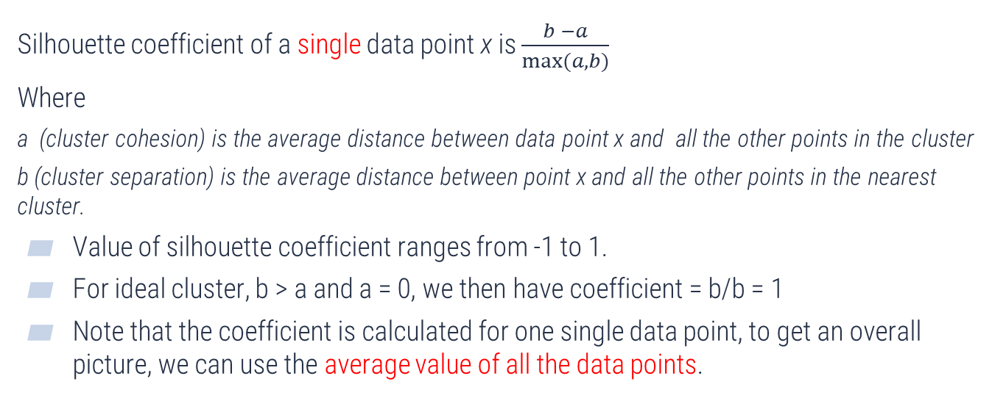
Silhouette Score
Silhouette coefficient of a single data point x is $\frac{b −a}{max⁡(a,b)}$
Where
a (cluster cohesion) is the average distance between data point x and all the other points in the cluster
b (cluster separation) is the average distance between point x and all the other points in the nearest cluster.
Value of silhouette coefficient ranges from -1 to 1.
For ideal cluster, b > a and a = 0, we then have coefficient = b/b = 1
Note that the coefficient is calculated for one single data point, to get an overall picture, we can use the average value of all the data points.

Slide 17
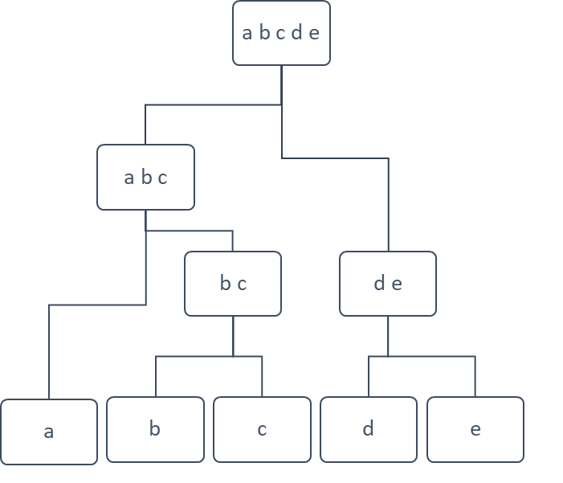
Hierarchical Clustering
Partition clustering algorithms like k-means create a single level cluster. Hierarchical clustering forms a tree structure that can suggest different clustering at different levels.
At the lowest level, each data object is in its own cluster
At the highest level, all data objects are in the same cluster
Two types of hierarchical clustering algorithms
Agglomerative clustering (bottom up)
Divisive clustering (top down)

Slide 18
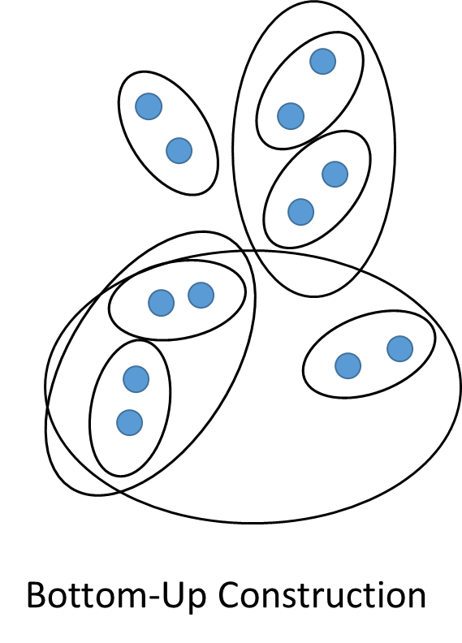
Agglomerative Clustering
Start with each object as a cluster
Iteratively merge the two clusters with the minimum distance from each other - until we are left with a single cluster comprising all objects

Slide 19
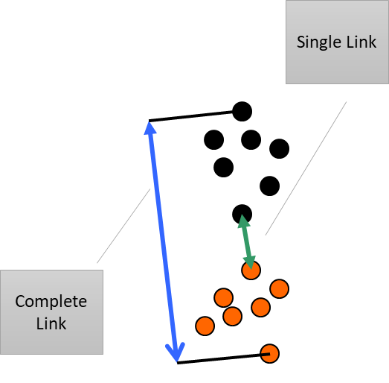
How to measure distance between clusters?
Calculation of the distance between two clusters is based on the pair-wise distances between members of the clusters.
Complete link: largest distance
Average link: average distance
Single link: smallest distance
Complete linkage gives preference to compact clusters
Single linkage can produce long stretched clusters

Slide 20
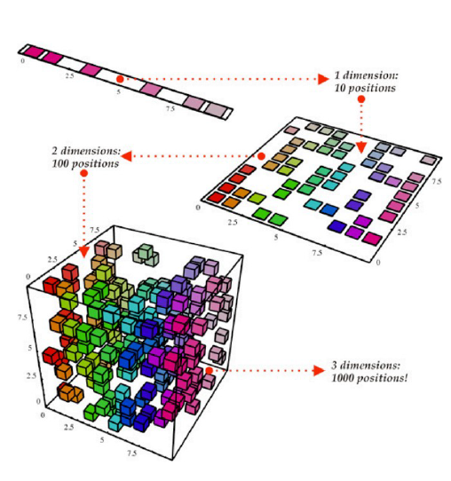
Dimensionality Reduction
What is Dimensionality Reduction?
In some cases, the higher the number of factors(features), the harder it gets to visualize the training set and then work on it.
Sometimes, most of these features are correlated, and hence redundant. This is where dimensionality reduction algorithms come into play.

Slide 21
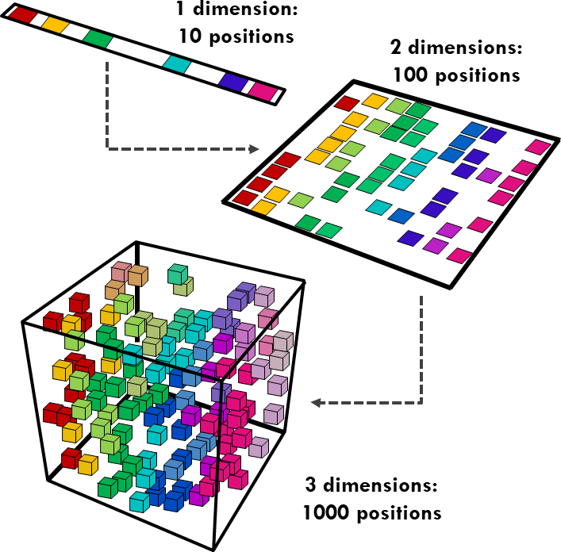
Curse of Dimensionality
Theoretically, increasing features should improve performance
In practice, more features may lead to worse performance
Required number of training examples increases exponentially with more dimensionality
Fortunately, there are techniques to reduce the number of features considerably, allowing us to narrow down to the most important ones
Dimensionality reduction is often a preprocessing step before training a model

Slide 22
Why Dimensionality Reduction?
Compress the dataset and speed up the training with less data
Remove highly correlated features (redundant features)
Remove the features that are not important or useful (irrelevant features)
Eliminate noise in the dataset
Train a more efficient model (yes and no, it depends on the dataset)
Enable data visualization (It is hard to visualize a high-dimensional space)

Slide 23
Drawbacks of Dimensionality Reduction
Some information is lost
Result in possible performance degradation of trained models
Need to find a balance
Computational cost of dimensionality reduction algorithms is not low for large datasets
Most have time and/or space complexity of 𝑂 (𝑚²) or higher, where m is the size of the dataset
The reduced set of features do not correspond to physical features, and can be hard to interpret

Slide 24
Key Ideas
Dimensional reduction exploits the fact that, in most real-world datasets, data points do not distribute uniformly across all dimensions
In effect, data points lie more or less on a lower-dimensional subspace within the original high-dimensional space
Some features have little variations or are highly correlated
Our goal is to identify the important features with significant variations, or generate new features to remove the correlated features

Slide 25
Example 1
Y
2-D (original)
In this case, we can remove Y feature without much information lost. Both indicate that the dataset is a linear relationship!
X
Remove Y
1-D (new)
X

Slide 26









Example 2
Y
Create a new feature P
to combine X and Y
(P = X + Y)
P
X
In this case, we combine features to present the key variation of the data.

Slide 27
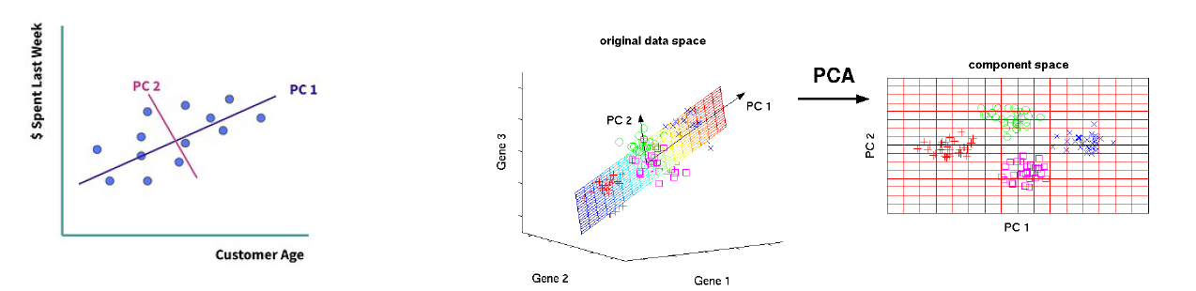
Principal Components Analysis
The purpose of PCA (principal component analysis) is to reduce the number of features included while still capturing the key information, or the spread of the data, as measured by the variance.
This new feature set is generated by linearly combining the features within the original feature set. The new features are called principal components.

Slide 28
THANK YOU!
Any questions?

Slide 29
Hands-on Lab
K-means clustering
Principal Components Analysis

Slide 30
Anomaly Detection
Brandon Ooi

Slide 31
Outline
What is an anomaly?
Applications of anomaly detection
Approaches and considerations when performing anomaly detection
Autoencoders
Isolation forest

Slide 32
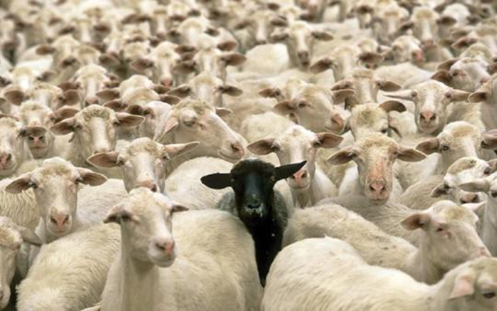
What is an anomaly
Object (or data point) that is different from most other objects (data points)
Anomaly is also called an outlier
Historically, in statistics, we want to remove ‘anomalies/outliers’ to improve analysis
Nowadays, anomalies/outliers are objects of interest (potentially negative impact)

Slide 33
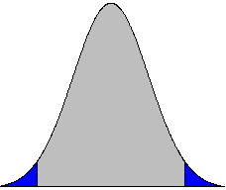
Data from different classes of objects or underlying mechanism
Disease vs non-disease
Fraud vs non-fraud
Natural variation
Tails on Gaussian (normal) distribution
Data measurement and collection errors
tail

Slide 34
Applications of anomaly detection
Network intrusion
Insurance / credit card fraud
Healthcare informatics / medical diagnostics
Industrial damage detection
Process monitoring
Image processing / video surveillance
Novel topic detection in text mining
and more . . .

Slide 35
Intrusion Detection
Network intrusion is attempts by malicious user to bypass security mechanism of network or computer system
Intrusion detection is the monitoring and analysis of events indicative of such attempts.
Challenges
Signature-based intrusion detection systems are based on ‘patterns’ of previous known attacks and cannot detect emerging cyber threats
Anomaly detection can help to detect previously unknown attacks but may suffer from false positives

Slide 36
Fraud Detection
Detection of commercial criminal activities such as credit card fraud, insurance claim fraud, insider trading, etc.
Malicious users might be:
Employees, actual customers, someone posing as a customer (identity theft)
Challenges
Fast and real-time detection
Mis-classification cost is high

Slide 37
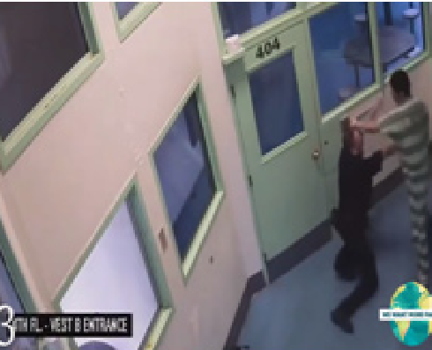
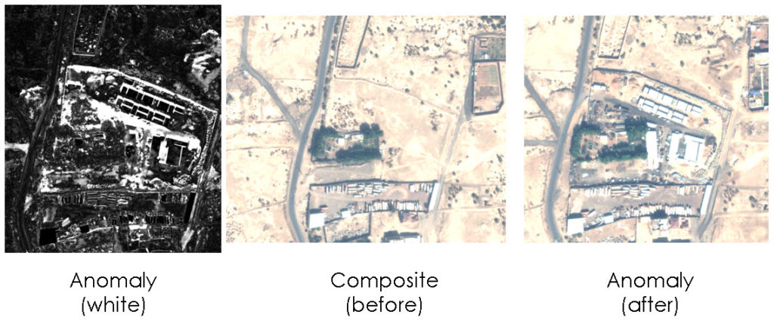
Image Analytics
Detecting outliers in an image monitored over time
Detecting anomalous regions within an image
Used in
video surveillance
satellite image analysis
mammography image analysis
Key Challenges
Detecting collective anomalies
Data sets are very large
image source: https://simularity2.bildz.com/satellite-anomaly-detection/

Slide 38
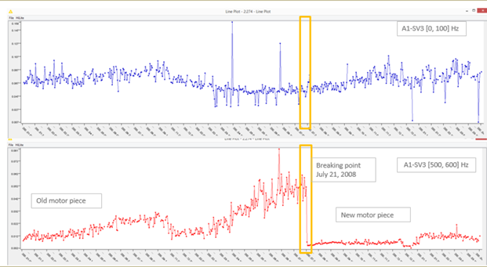
Industrial Monitoring and Preventive Maintenance
Detect faults and failures in complex industrial systems, such as anomalous aircraft (engine) / fleet usage, abnormal engine behaviour, degraded or faulty parts
Key challenges
Data is extremely large, noisy, and unlabeled
Most of applications exhibit temporal behavior
Detected anomalous events typically require immediate intervention

Slide 39
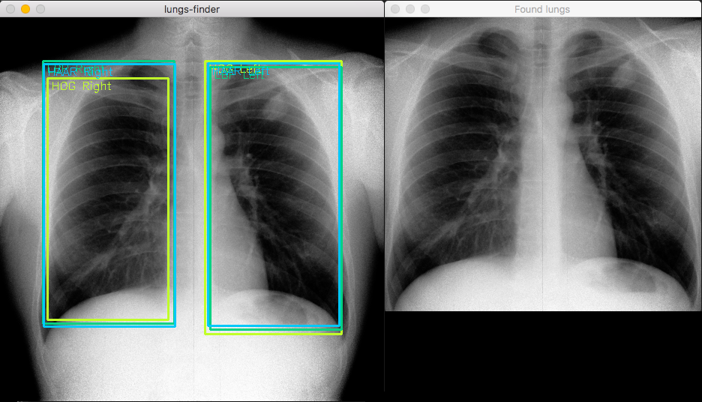
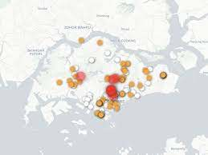
Healthcare
Detect anomalous patient records
Indicate disease outbreaks, instrumentation errors, etc.
Key challenges
Only normal labels available
Misclassification cost is very high
Data can be complex: spatio-temporal

Slide 40
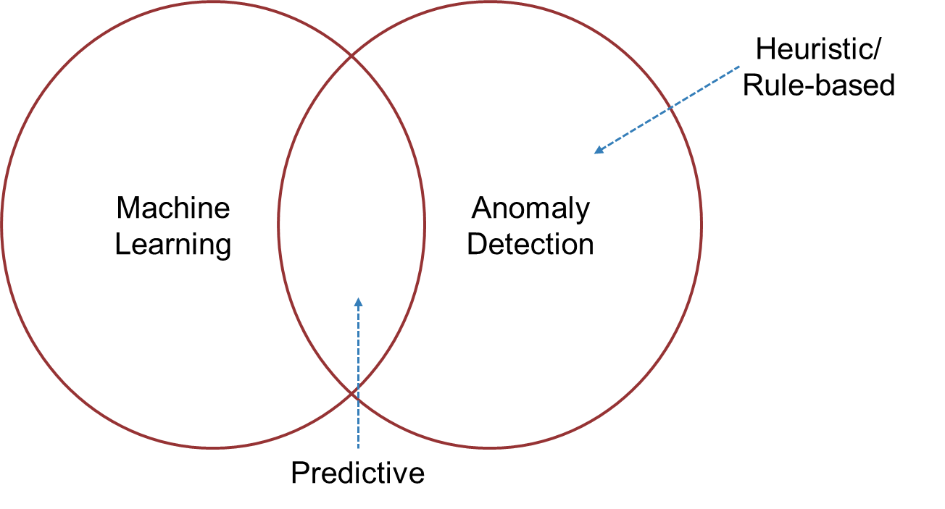
Anomaly Detection and Machine Learning
Need to know in advance what an outlier looks like eg transactions > $X flagged as anomaly

Slide 41
Approaches to Anomaly Detection
Supervised
Labels available for both normal data and anomalous data
Can be treated as classification problem (but with heavy data imbalance)
Unsupervised
No labels available
Based on assumption that anomaly is rare compared to normal data
Semi-supervised
Labels available only for small set of data (normal/anomalous)
Train using unlabeled data, but evaluate using labelled data

Slide 42
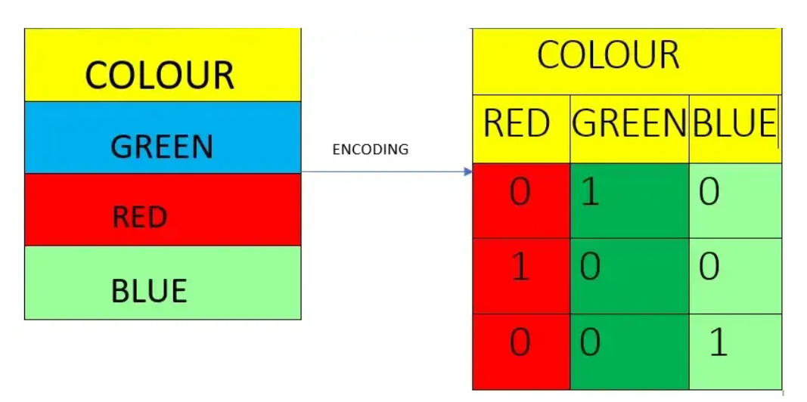
Feature Engineering
Categorical features represent types of data divided into categories
Example, there are two card types: credit and debit.
Categorical features with meaningful order, example unsatisfactory, satisfactory, and excellent—are ordinal categorical features.
To be used in most machine learning algorithms, non-numeric features must be transformed into numbers representing each feature’s value.
Example, one-hot-encoding

Slide 43
Feature Engineering
Other encoding strategies:
Target encoding - features are replaced with the probability of the categorical value corresponding to the target, e.g. if 3% of fraudulent transactions are of card type “debit,” then the value “debit” is replaced with .03.
Frequency encoding - features are replaced with the count of the categorical value, e.g. add a column for how frequently a card region occurs in transactions
Aggregation encoding - adds features based on feature aggregation statistics, such as mean or standard deviation for groups of features, e.g. add a column containing mean card transaction amounts

Slide 44
Output of Anomaly Detector
Label
Each test instance is given a normal or anomaly label (e.g. 1 for anomaly, 0 for normal)
Score
Each test instance is assigned an anomaly score
allows outputs to be ranked
requires an additional threshold parameter

Slide 45
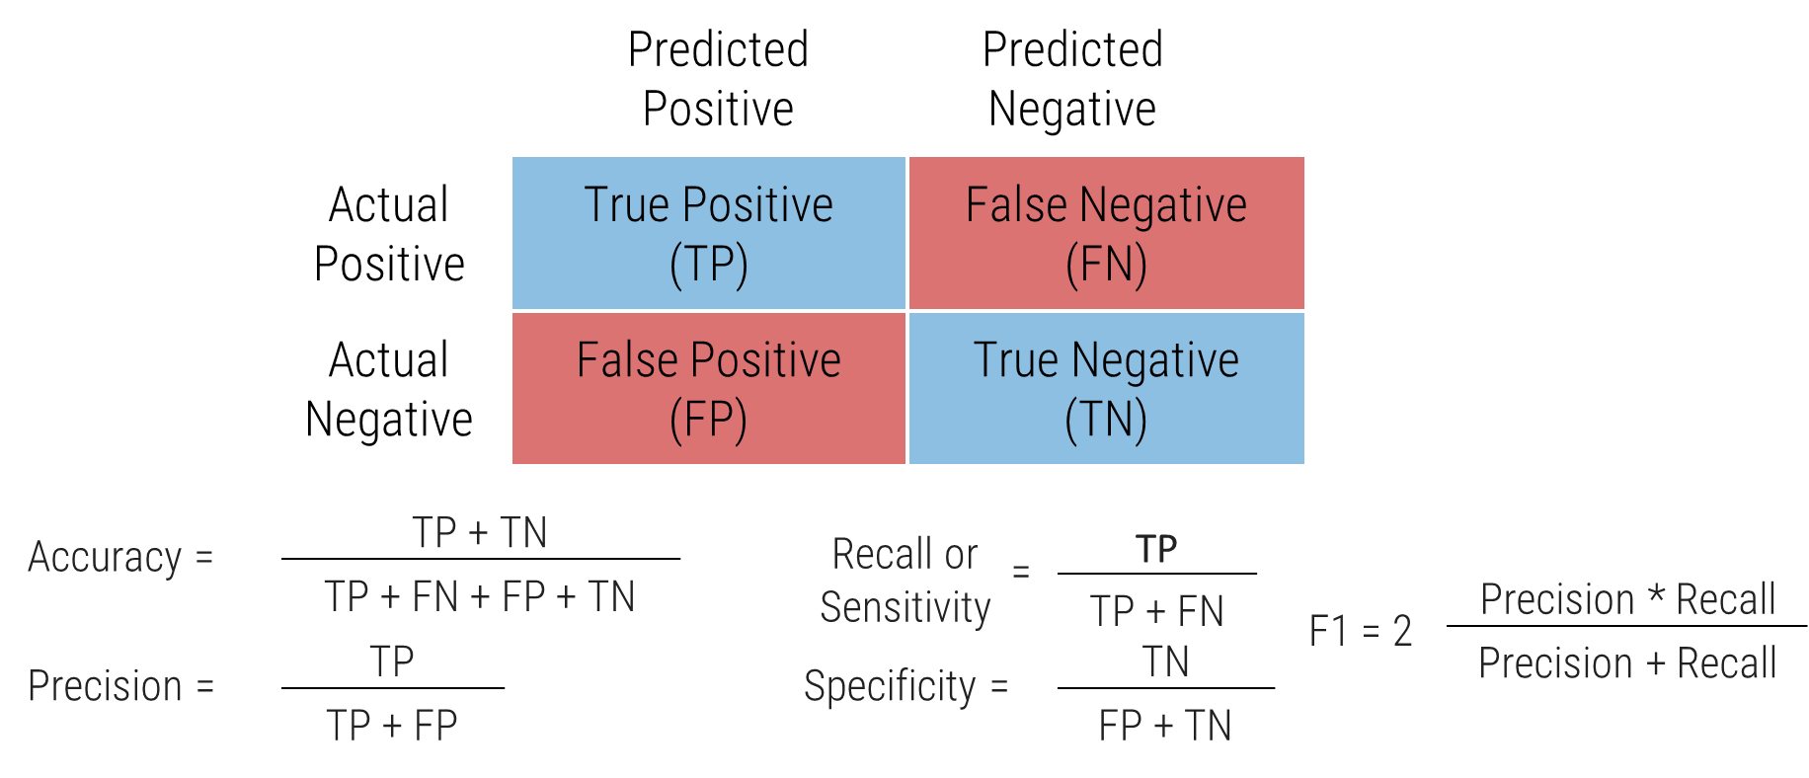
Evaluation Metrics

Slide 46
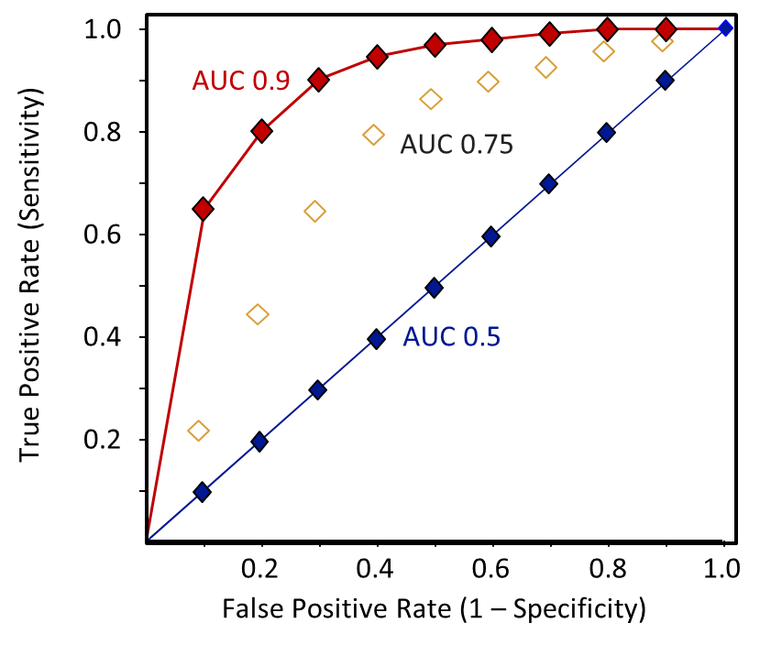
Area Under Curve (AUC)

Slide 47
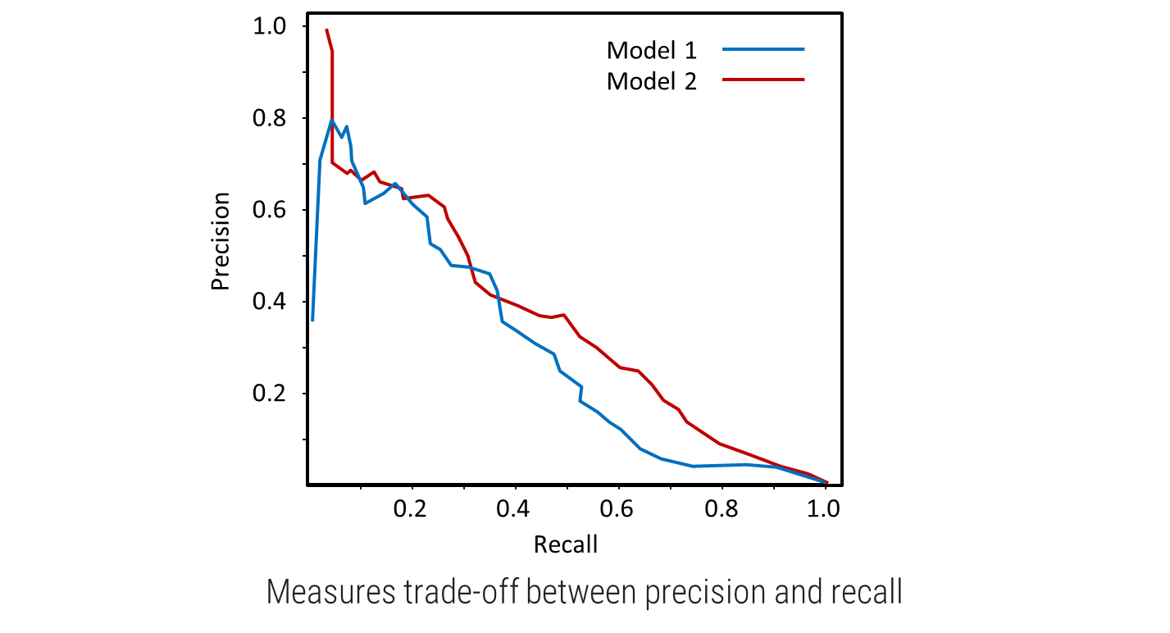
Precision-Recall Curve

Slide 48
What should we use to evaluate?
Accuracy is only reflecting the underlying class distribution.
If 99% of the dataset is normal data, a ‘dumb’ anomaly detector that always guess ‘normal’ will have an accuracy of 99%!
Precision/Recall is a better metric for evaluating anomaly detector
There is trade-off between precision and recall:
Higher precision → lower recall
Higher recall → lower precision

Slide 49
Precision-Recall Considerations
Optimizing for precision
may be useful when the cost of failing to detect the anomaly is low, or when we want to be certain that the anomaly is a true anomaly
Optimizing for high recall
may be more appropriate when the cost of a false negative is very high
e.g. in airport security, it is better to flag many items for human inspection (low cost) in order to avoid the much higher cost of incorrectly admitting a dangerous item onto a flight.

Slide 50
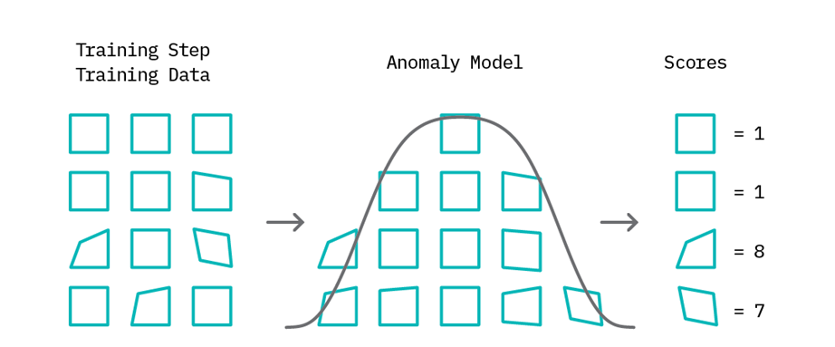
Anomaly Detection as learning normal behaviour
In the training phase - build a model of ‘normal’ behaviour using available data
training data may or may not include abnormal samples
anomaly score is then assigned to each data point that represents a measure of deviation from normal behaviour.

Slide 51
Anomaly detection as learning normal behaviour
In the testing phase
Use threshold-based anomaly tagging based on the range of scores assigned by the model
Threshold provides an easy lever to tune the “sensitivity” of the anomaly detector
Can use statistical (e.g. z-score) or proximity (e.g. distance) methods for measuring deviations

Slide 52
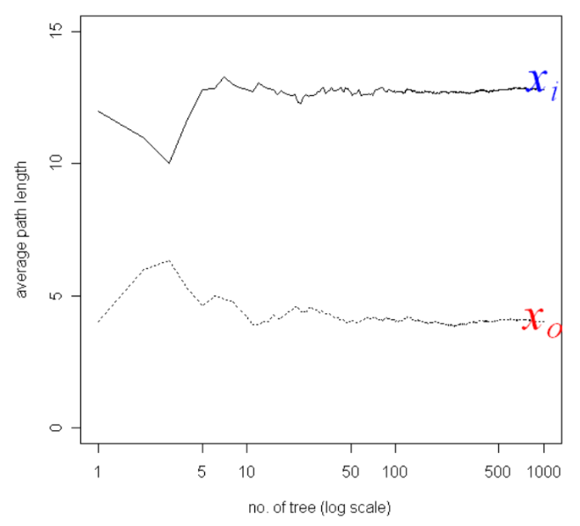
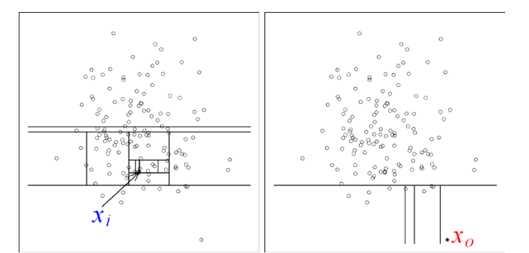
Isolation Forest
Similar to random forest, but for anomaly/outlier detection
Build multiple decision trees to isolate observation in leaves
Similar observations will take more random splits to isolate observation -> have shorter path lengths

Slide 53
Isolation Forest – Intuitive Explanation
Isolation Forest assigns an anomaly score to data points based on how easy they are to separate from the rest of the data.
The easier a data point is isolated from the majority of the data, the more likely it is to be an anomaly.
But how does the model determine whether a point is ‘easier’ to isolate in practice?
An intuitive explanation is as follows: The model tries to isolate points by asking random questions of the following form:
Is feature x larger or smaller than threshold y?

Slide 54
Isolation Forest – Intuitive Explanation
Both feature x and the threshold y are chosen randomly.
Given enough random questions, eventually every unique data point will be isolated.
Isolation Forest considers points that require more such questions as harder to isolate and thus more likely to be anomalies.
To get an intuition for why this works, consider the following two processes of isolation for different data points. Let’s first look at a point that could be considered an anomaly in the sense that there are not many other points similar to it.

Slide 55
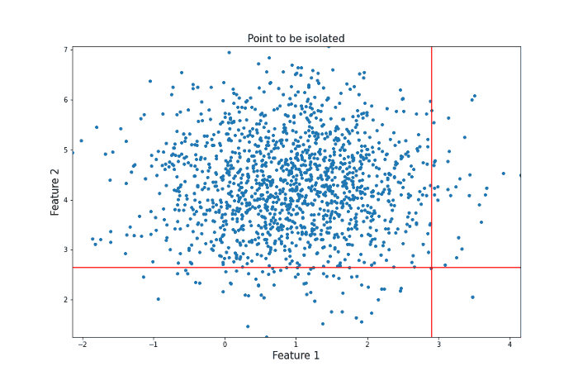
Isolation Forest – Intuitive Explanation
Consider the anomalous point in the figure.
It took 12 random questions to completely isolate the point.

Slide 56
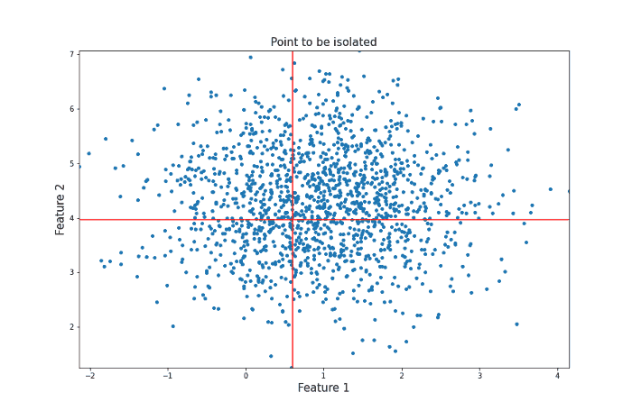
Isolation Forest – Intuitive Explanation
Consider the ‘normal’ point in the figure.
It took 22 decisions to completely isolate the point. T
This is subject to a lot of variance, so the actual Isolation Forest model repeats this procedure many times to arrive at a final anomaly score.

Slide 57
Isolation Forest – Important Hyperparameters
Contamination – The amount of contamination of the data set, i.e. the proportion of outliers in the data set. Used when fitting to define the threshold on the scores of the samples
n_estimators - The number of base estimators in the ensemble.
max_samples - The number of samples to draw from X to train each base estimator.

Slide 58
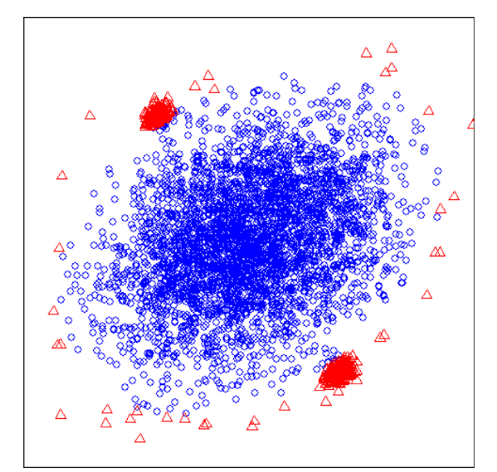
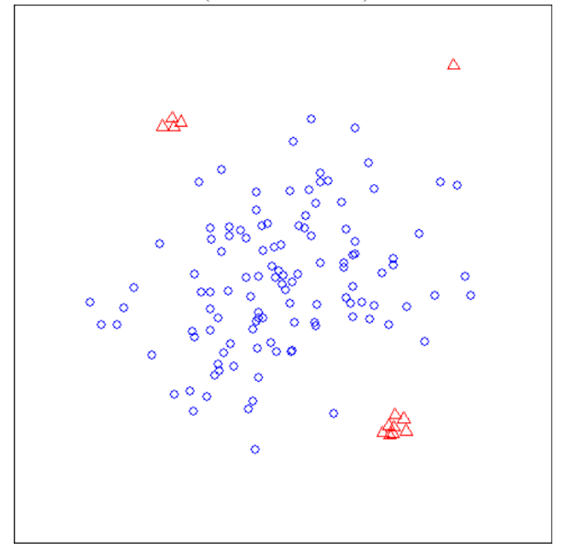
Characteristics of Isolation Forests
Swamping -> Wrongly identifying normal instances as anomalies when normal instances are too close to anomalies
Masking -> Too many anomalies make it difficult to identify anomalies
Sub-sampling (random selection of instances without replacement) helps with this
Possible limitations: 1. Final anomaly score depends on contamination parameter (% of anomalous data) 2. Branching can sometimes create bias in decision boundary

Slide 59
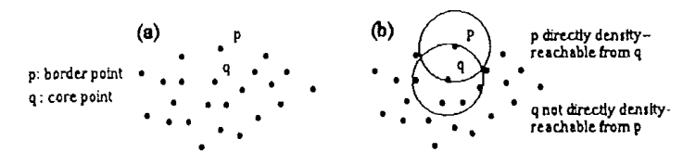
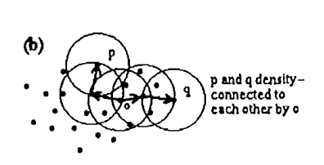
DBSCAN
Requires two input parameters – epsDist, minSamp
Density based clustering
Each point of a cluster the neighborhood of a given radius has to contain at least a minimum number of points -> the density in the neighborhood has to exceed some threshold.
Points that don’t belong to any cluster are identified as outliers
Let D be a database of points. A cluster C is a non-empty subset of D satisfying the following conditions:
V p, q: if p is an element of C and q is density-reachable from p, then q E C
V p, q E C: p is density-connected to q.

Slide 60
DBSCAN Algorithm
To find a cluster, DBSCAN starts with an arbitrary point p and retrieves all points density-reachable from p.
If p is a core point, this procedure yields a cluster
If p is a border point, no points are density-reachable from p and DBSCAN visits the next point of the database
If two clusters C1 and C2 are very close to each other, it might happen that some point p belongs to both, C1 and C2. In this case, point p will be assigned to the cluster discovered first.

Slide 61
DBSCAN Algorithm
As long as there is no point unvisited, a new point is chosen randomly.
All the points within eps distance from the current point are of the same cluster.
The algorithm recursively continues on each of these last visited points to find more points that are within eps distance from themselves.
If minPts points are collected, then a cluster is officially formed.
Once a cluster is formed, and no more points can be added, the algorithm chooses another point randomly from the ones that haven’t been visited yet.

Slide 62
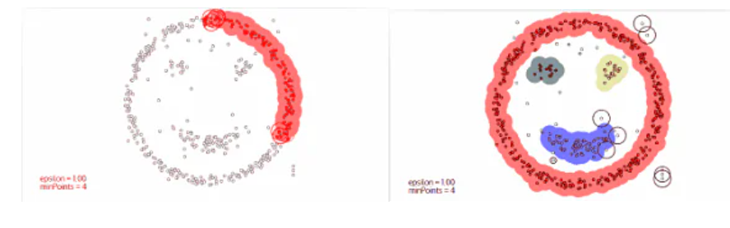
DBSCAN Algorithm

Slide 63
PCA for Anomaly Detection
Although PCA is primarily used for dimensionality reduction, it can also be used to detect anomalies
By only choosing the important principal components that explain the majority of the variance, we can recreate an approximation of the original data through an inverse transform (pca.inverse_transform)
The difference between the reconstructed data and the original data is the reconstruction error
For anomalies, this reconstruction error is high
Note that this method may not work very well if data cannot be explained using linear combination of features
Additionally, explainability may suffer

Slide 64
THANK YOU!
Any questions?

Slide 65
Hands-on Lab
Isolation Forest
Feature Engineering
Explainability
DBSCAN
Pycaret

